Slide 1

Green Pace
Security Policy Presentation
Developer: Nicholas Chavez

Slide 2

OVERVIEW: DEFENSE IN DEPTH
This is a model to give an overview of the various methods of defense that are used to maintain a solid blueprint for secure coding.

Slide 3
THREATS MATRIX
Based on Secure Coding standards there are certain levels of vulnerability that are measured and their impact. This threat matrix shows those levels.
Likely Threats that are considered very likely to happen | Priority Standard with a high relevancy
Low priority Standard with a low relevancy | Unlikely Threats that are not likely to happen.

Slide 4
10 PRINCIPLES
Validate input data
Always heed compiler warnings
Architect and design with security policies in mind
Keep it simple
Deny by default
Adhere to the principles of least privilege
Sanitize data sent from other systems
Always practice defense in depth
Use effective quality assurance tools and techniques
Adopt the appropriate secure coding standards for your project

Slide 5
CODING STANDARDS
Do not cast an out out-of-range enumeration value
Use valid references, pointers, and iterators to reference elements of a container
Do not attempt to create a std::string from a null pointer
Do not sote an already-owned pointer value in an unrelated smart pointer
Properly deallocate dynamically allocated resources
Use a static assertion to test the value of a constant expression
Handle all exceptions
Do not alternately input and output from a file stream without an intervening positioning call
Do not invoke virtual functions from constructors and destructors
Value-returning functions must return a value from all exit paths

Slide 6
ENCRYPTION POLICIES
Encryption in flight - This is the process of encrypting the data while it is being transmitted. Data may be unencrypted while it is at rest but encrypted while it is being transmitted for additional protection.
Encryption at rest - Encryption is rest was designed to prevent attackers from accessing unencrypted data by ensuring the data becomes encrypted on the disk. If the attackers somehow obtains the hard drive with the encrypted data but not the encryption key, they must brute force their way through the encryption to access the data
Encryption in use - Compromising data in use enables access to encrypted data at rest and data in motion. Someone who has access to the random access memory can parse the memory to locate the encryption key for the data at rest.

Slide 7
TRIPLE-A POLICIES
Authentication - The process where the user is confirmed as someone who is authorized to access the system. This is typically done by having users login to a system with a verified username and password. New methods use multiple authentication methods to confirm users.
Authorization - This determines the level of access a user can have within the system. This allows the system to differentiate what users can do what in the specific system
Accounting - The process of monitoring what a user does with their level of access on the system. This will keep track of when and what the user has accessed since they logged in to the system.

Slide 8
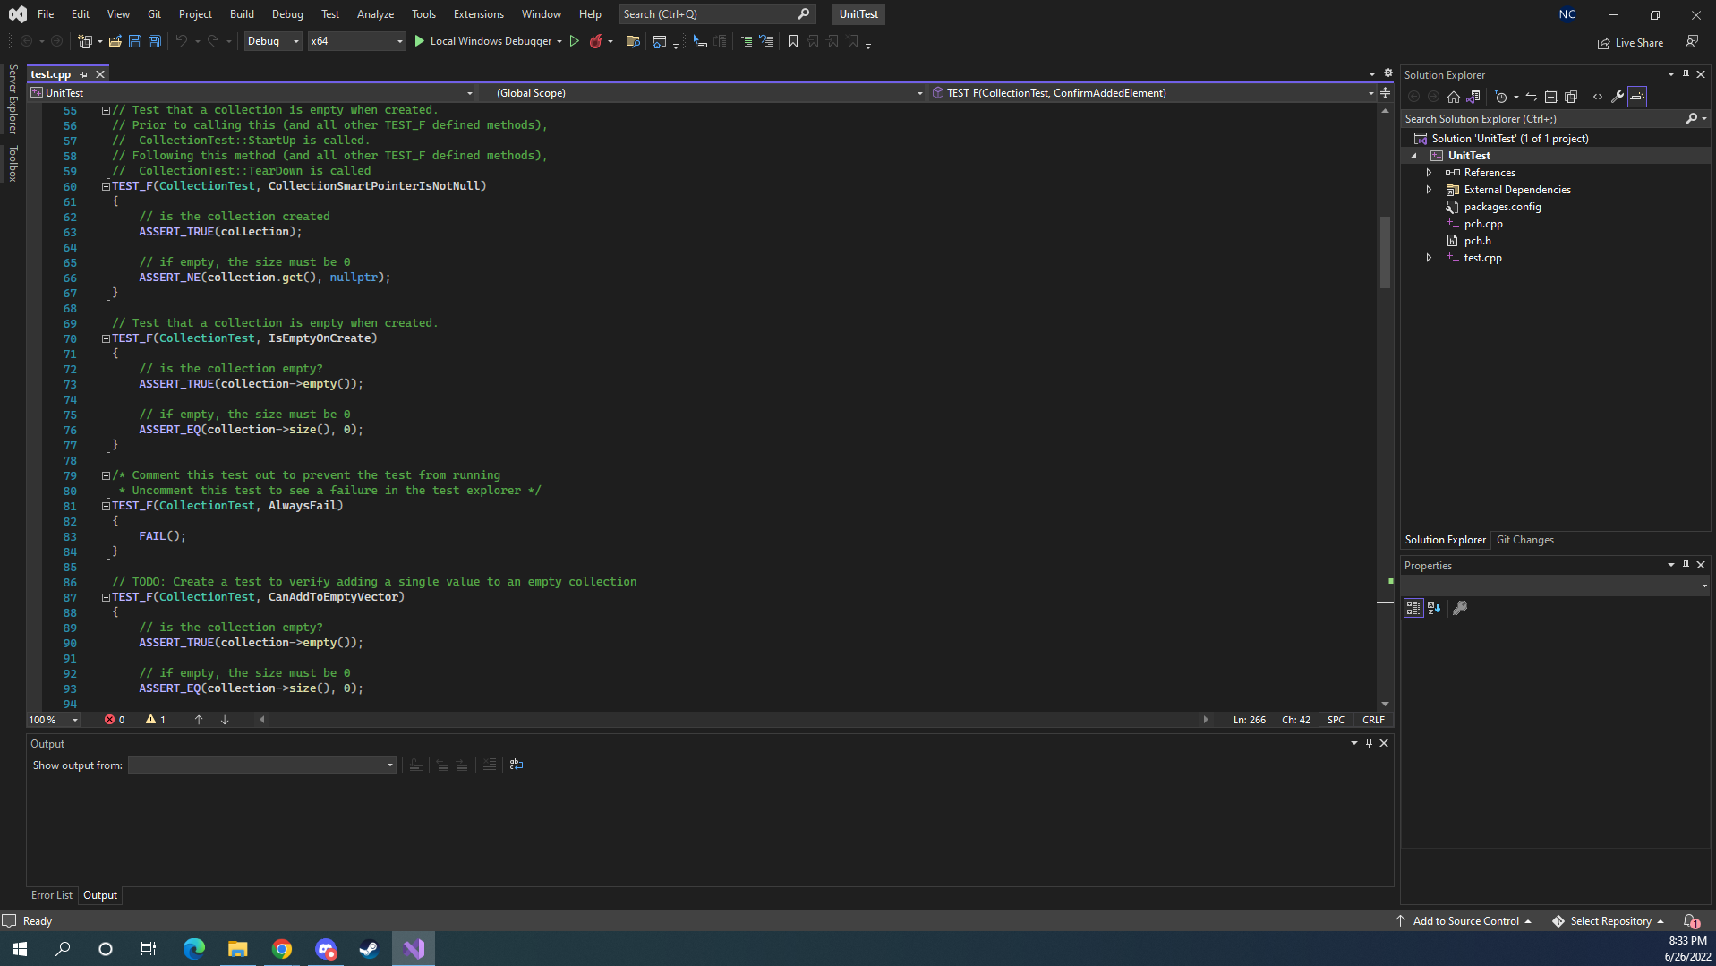
Unit Testing
Unit test to verify collections are
empty upon creation and values
are not being overwritten.

Slide 9

AUTOMATION SUMMARY

Slide 10
TOOLS
DevSecOps pipeline is a secure coding method that uses a full circle approach for enforcing a policy that has infrastructure built on efficiently keeping code secure
This is a strong structure for a system to employ. It is always best to keep defense in depth in mind and always test early and often to detect and fix any flaws in the system.

Slide 11
RISKS AND BENEFITS
There is no way to complete eliminate risk when coding, however, systems can be designed with the mindset that there will be flaws and vulnerabilities. This means that those managing the system must be vigilant and studied in prevention techniquest. This is highly critical to the success of the policy

Slide 12
RECOMMENDATIONS
There are no current recommendation for change the current techniques and systems being employed should be sufficient in ensuring a secure system and making sure user information is secure.

Slide 13
CONCLUSIONS
After extensive review the principles and standards outlined above show how we plan on handling security going forward. This will confirm we are in compliance across the board for the necessary security measures. We will make sure to stay diligent and review policies frequently and make and implement changes when necessary.

Slide 14
REFERENCES

